Slide 1

HELLO! I’m…
<p>Jed Ernstzen</p>
<p>I will be Presenting My JSL11 Project</p>

Slide 2
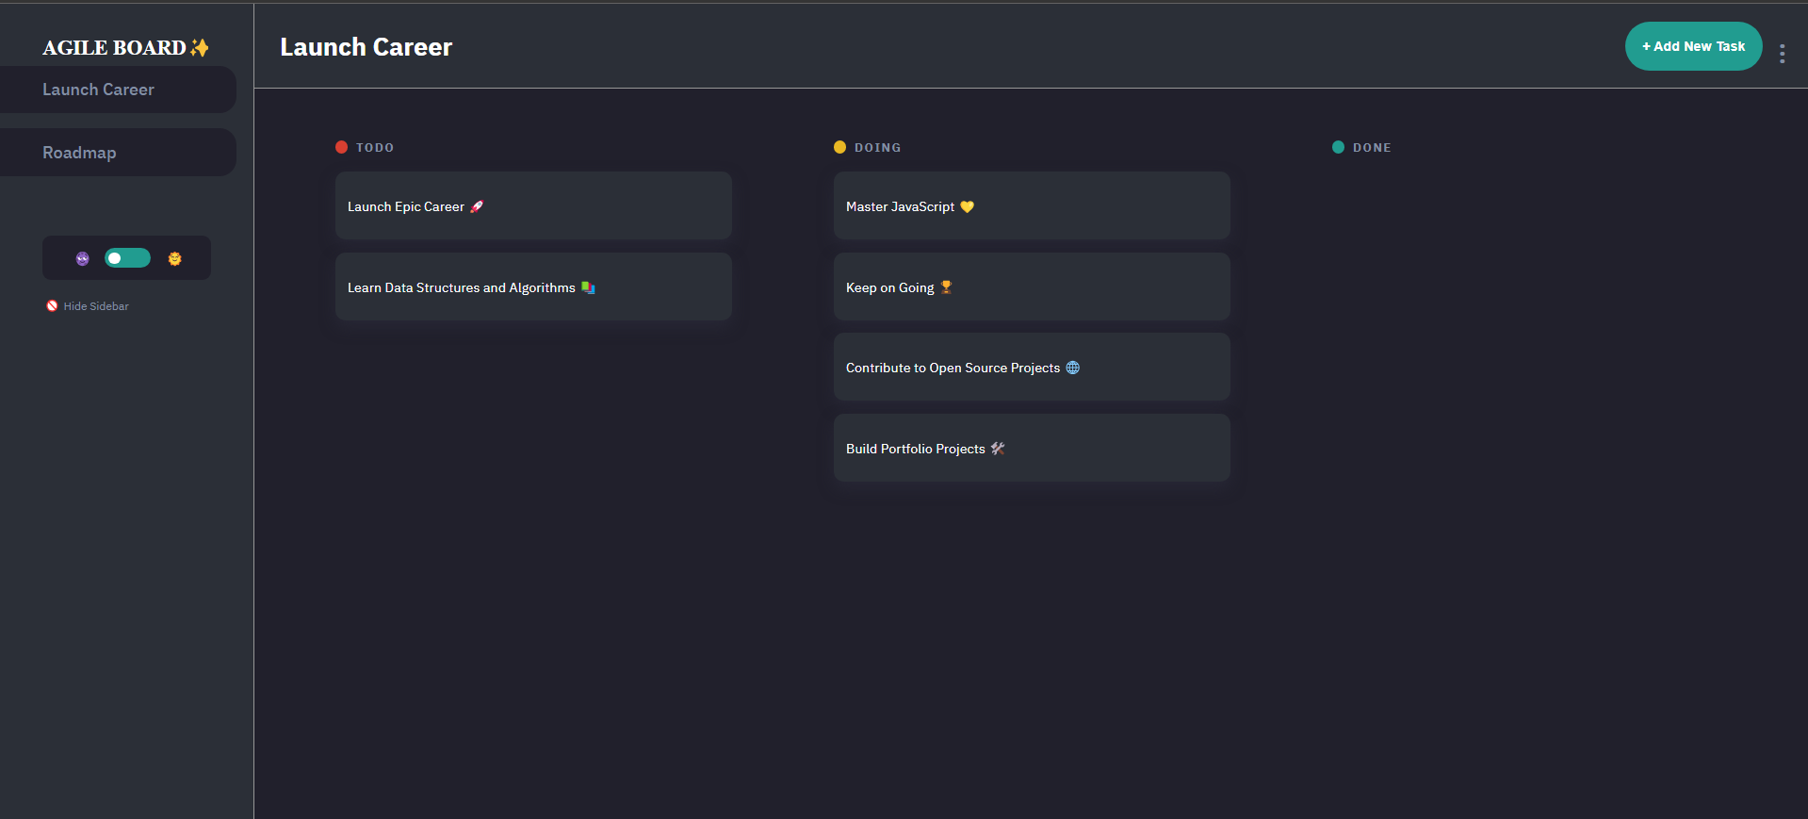
My Agile Board Capstone Project

Slide 3
TABLE OF CONTENTS.
01
02
03
04
05
6-7
Imports and Initialization
DOM Elements and Global Variables
Task Management
Board Management
Event Handling
Task Editing,Initialization and EntryPoint

Slide 4
IMPORTS AND INITIALIZATION
01

Slide 5
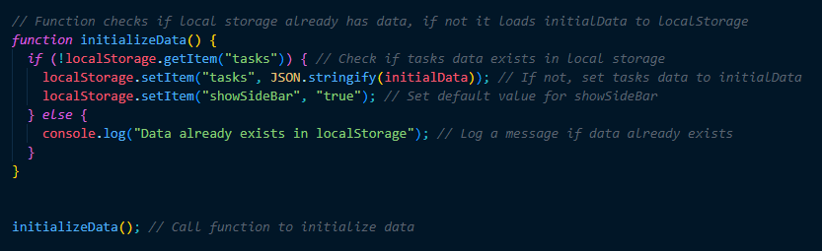
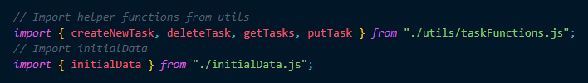
IMAGES

Slide 6
DOM ELEMENTS AND GLOBAL VARIANTS
02

Slide 7
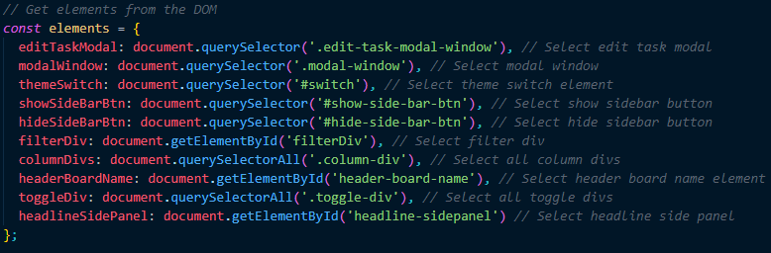

IMAGES

Slide 8
TASK MANAGEMENT
03

Slide 9
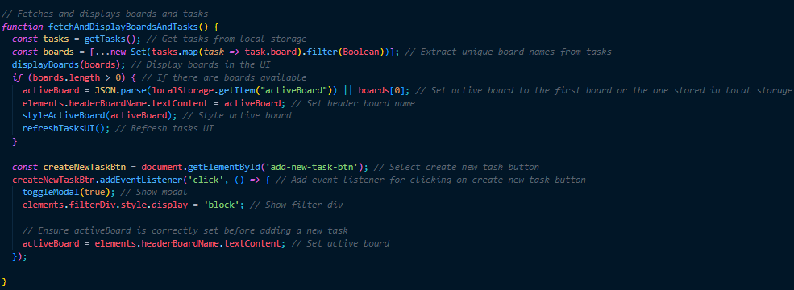
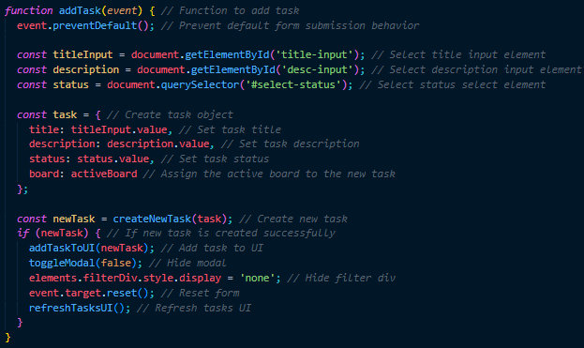
Images

Slide 10
BOARD MANAGEMENT
04

Slide 11
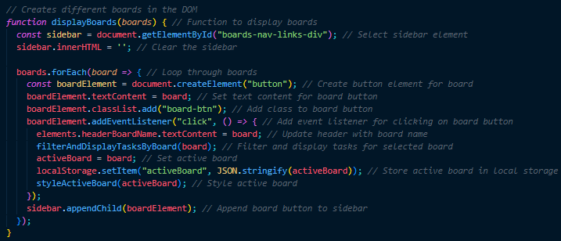
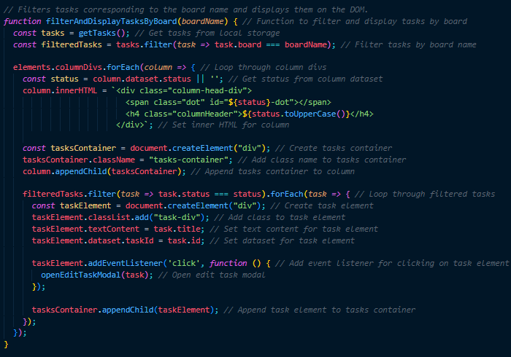
IMAGES

Slide 12
EVENT HANDLING
05

Slide 13
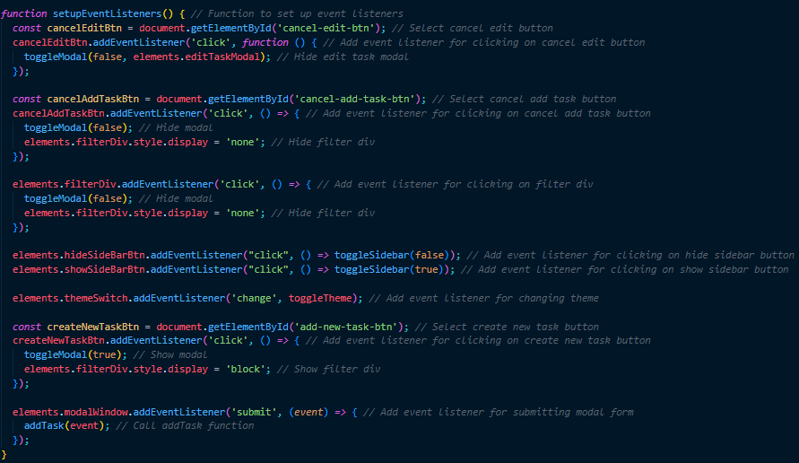
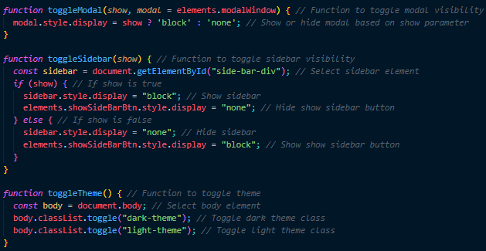
IMAGES

Slide 14
TASK EDITING INITIALIZATION AND ENTRY POINT
6-7

Slide 15
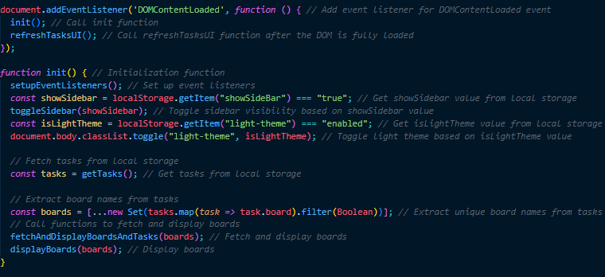
IMAGES

Slide 16
THANK YOU!
jedernstzen@gmail.com
Linkedin.com/in/jedernstzen
Do you have any questions?

Slide 17
CREDITS.
Presentation Template: SlidesMania
Sample Images: Unsplash
Fonts used in this presentation: Roboto Mono and Roboto Bold

